Slide 1

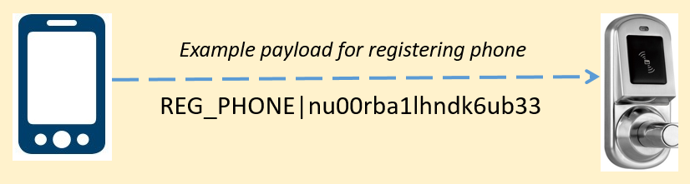
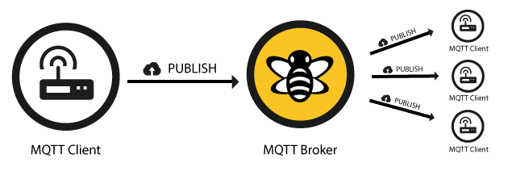
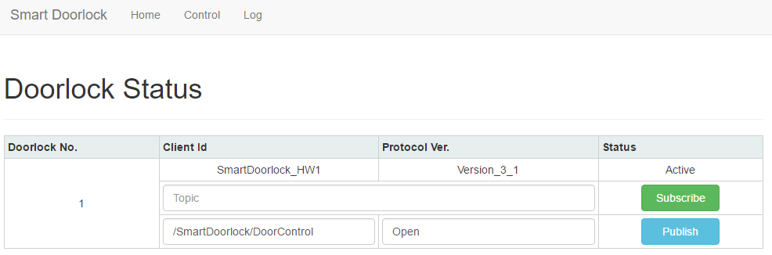
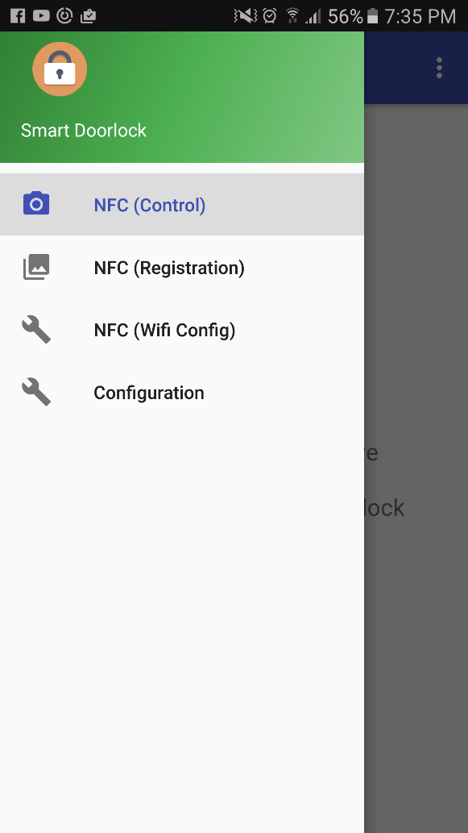
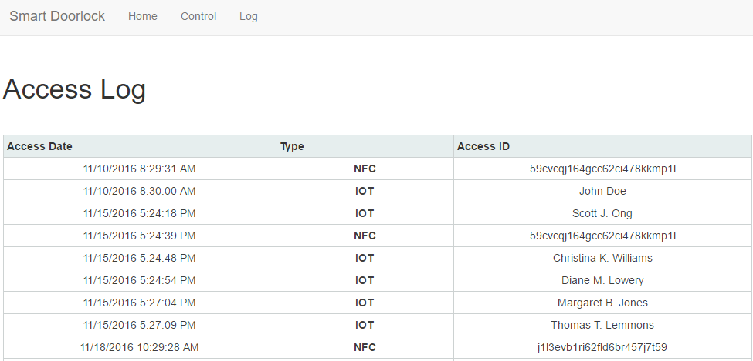
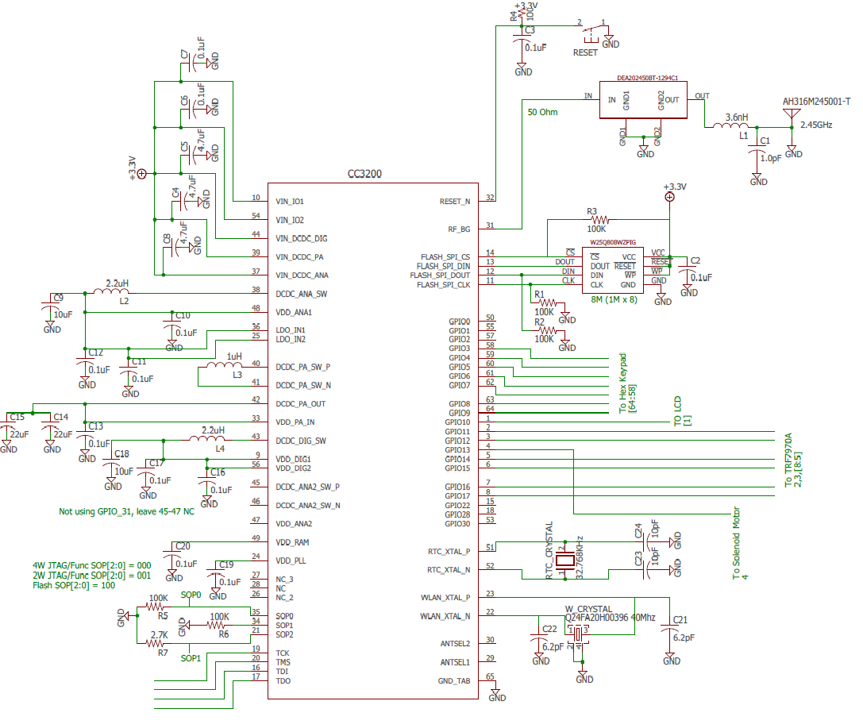
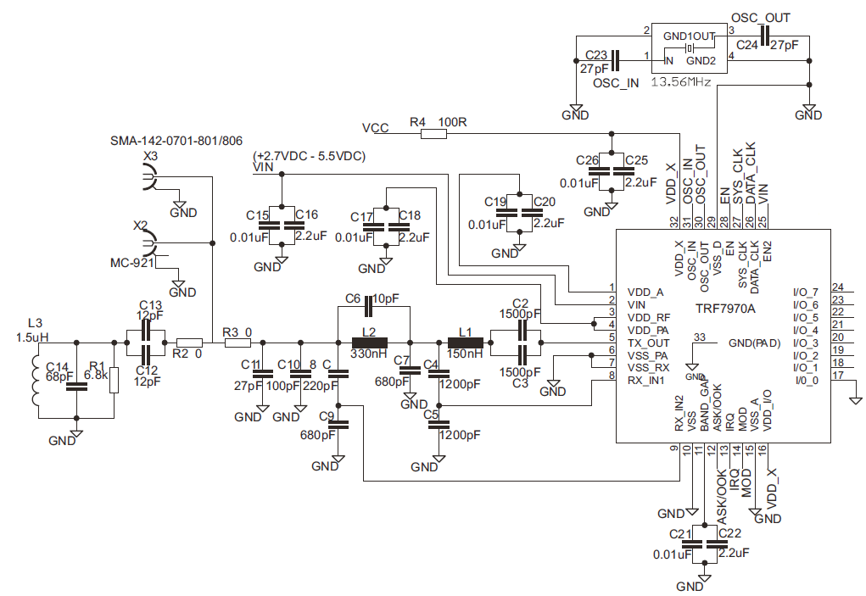
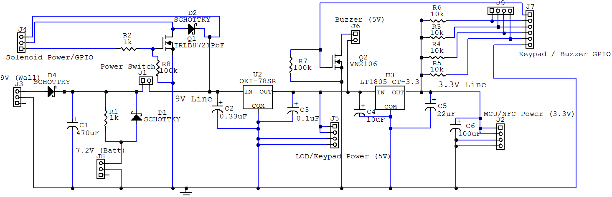
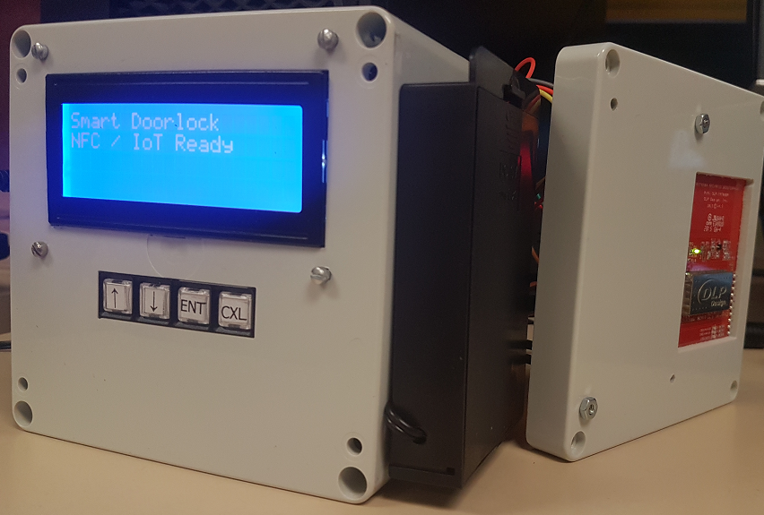
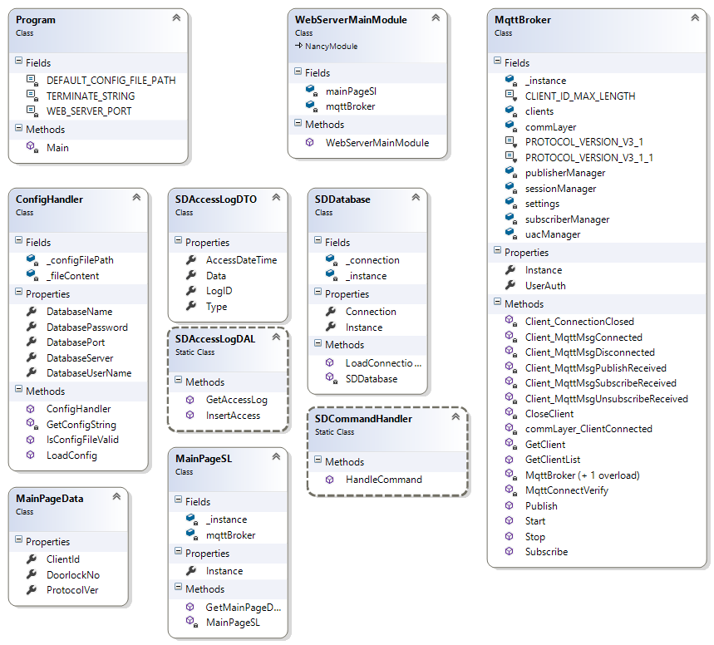
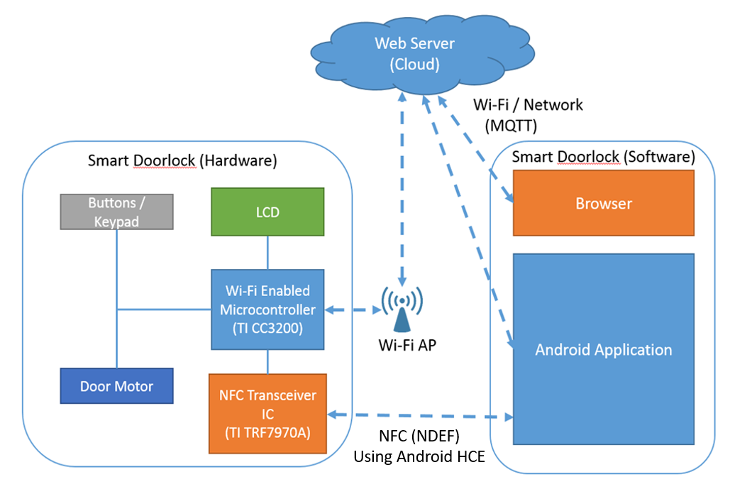
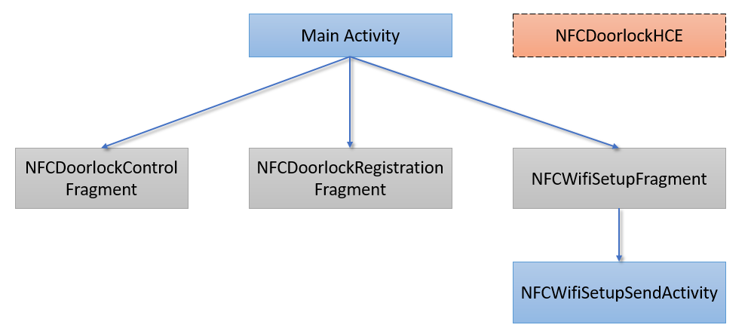
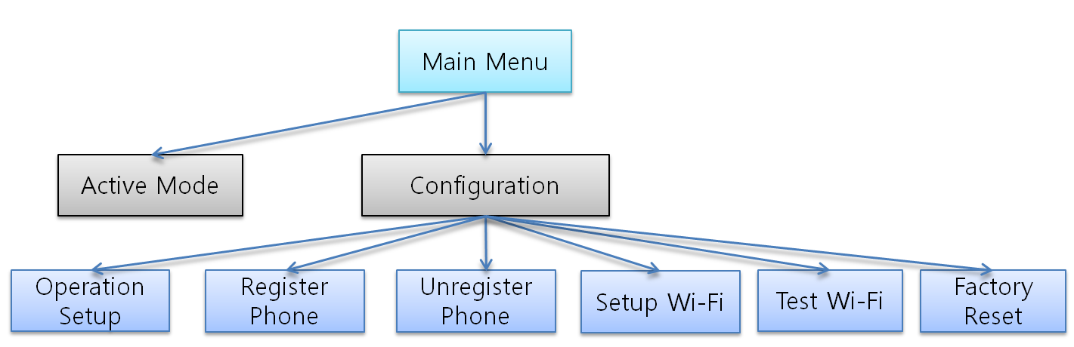
Smart Doorlock
Department of
Electrical and Computer Engineering
Sokwhan Huh
Overview
Technology Background
Applications
Traditional mechanical locks have numerous issues pertaining to accessibility and security. Keys can be misplaced, broken, stuck in the lock and may not even turn, causing great deal of problems to home owners. Mechanical locks are easily picked by people with minimal knowledge in lock picking and keys are vulnerable to replication. A new type of door lock needs to be designed to better secure your assets.
With the advent of NFC (Near Field Communication) and IoT (Internet of Things), virtually everything around us can now be controlled via nothing more than a smartphone. The intent of this project is to provide a practical solution to aforementioned problems with traditional mechanical locks by applying both NFC and IoT technologies to an electronic door lock.
Near Field Communication
Internet of Things
IoT Control Panel
Android Application
NFC is a collection of communication protocols that enable two electronic devices to establish communication in a close proximity, typically within 5cm if each other.
Android HCE (Host Based Card Emulation) technology is used to emulate ISO 14443 type NFC tags. An encrypted payload from the smart phone is created in NDEF structure and sent to the door lock.
MQTT (Message Queue Telemetry Transport) is a publish/subscribe based protocol specifically designed for use in IoT. Web server on cloud acts as a MQTT broker and Smart Doorlock acts as a MQTT client. Messages such as LOCK_CONTROL can published from the broker to control the door lock.
Access Log Audit
Features
Hardware Design
NFC Capability
Open the door lock with NFC using an Android device.
IoT Capability
Open the door lock over the internet using an Android device or by accessing Smart Doorlock’s web server with an internet browser.
Enhanced Security System
Manage user access by registering smartphones.
Entries are logged and can be audited.
Robust Operation
24 hour rechargeable battery backup system.
CC3200 Circuit Diagram
TRF7970A Circuit Diagram
Cost Summary
CC3200 Launchpad | $ 29.99
TRF7970A NFC BoosterPack | $ 24.99
Keypad | $ 9.04
6xAA Battery Holder | $ 2.50
20x4 LCD Display | $ 22.71
Solenoid Lock | $ 14.95
Enclosure | $ 21.94
Miscellaneous | $ 10.00
Total | $ 136.12
Operations
LCD/Solenoid/Keypad Driver Circuit Diagram
Final Design
Smart Doorlock supports the following operations that can be navigated using the keypad:
Active
Configuration
Operation Setup
Register Phone
Unregister Phone
Setup Wi-Fi
Test Wi-Fi Connection
Factory Reset
Reboot
Software Design
Microcontroller Boot Sequence
NFC Task Diagram
Web Server Class Diagram
System Block Diagram
Acknowledgements
For support and guidance in creating this project, I would like to give my special thanks to:
University of Wyoming
Dr. Steven Barrett
Victor Bershinsky
George Janack
Mike
LG Electronics Gasan R&D
Junseo Son
Nexol System
Jaesik Cho
Android Application Flow Diagram
Microontroller Menu Flow Diagram
http://sd.ufwfate.net/ Funded by Volpi and Cupal Senior Design Fund

